Slide 1

Phishing Emails Detection Tool
by Smita Jagtap and Jigisha Bagul

Slide 2

Understanding Phishing
What is Phishing?
Impact
Need for Automation
Fraudulent attempts to steal sensitive data via emails
Financial loss, data breaches, reputation damage
High email volume makes manual detection unfeasible

Slide 3

Problem Statement
Growing Phishing Volume
Manual Detection Challenge
Millions of phishing emails daily
Time-consuming and error-prone
Common Scenarios
Fake login pages, urgent payment requests

Slide 4
Project Objectives
Detection
Feature Extraction
Model Accuracy
Use ML to identify phishing emails
Apply NLP techniques for relevant indicators
Achieve high precision and recall

Slide 5
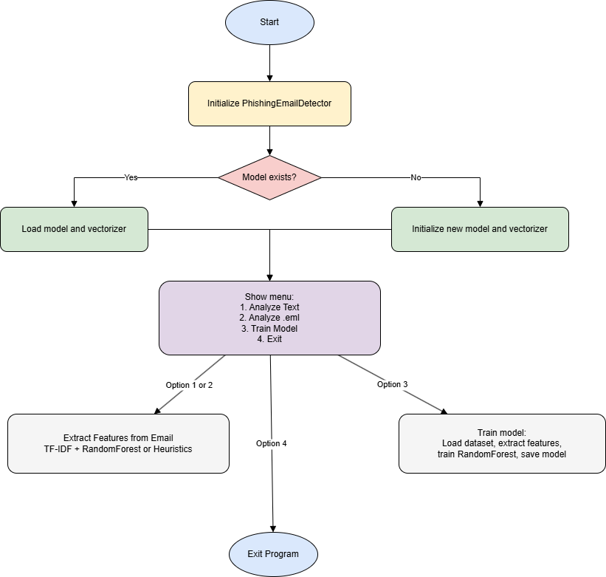




Project Methodology
Data Collection
Gather emails from diverse sources
Feature Extraction
Natural Language Processing (NLP)
Model Training
RandomForestClassifier algorithm
Evaluation
Test accuracy and performance metrics

Slide 6
Dataset & Feature Extraction
Dataset
Features
Pre-processing
Thousands of legitimate & phishing emails
Link counts in email body
TF-IDF vectorization for text normalization
Urgent/attention keywords
Multiple sources including public corpora
Sender reputation scores

Slide 7

Model & Techniques
Classifier
RandomForestClassifier for robustness
NLP
TF-IDF for feature vector construction
Training
Cross-validation for model reliability
Validation
Performance monitored via metrics

Slide 8
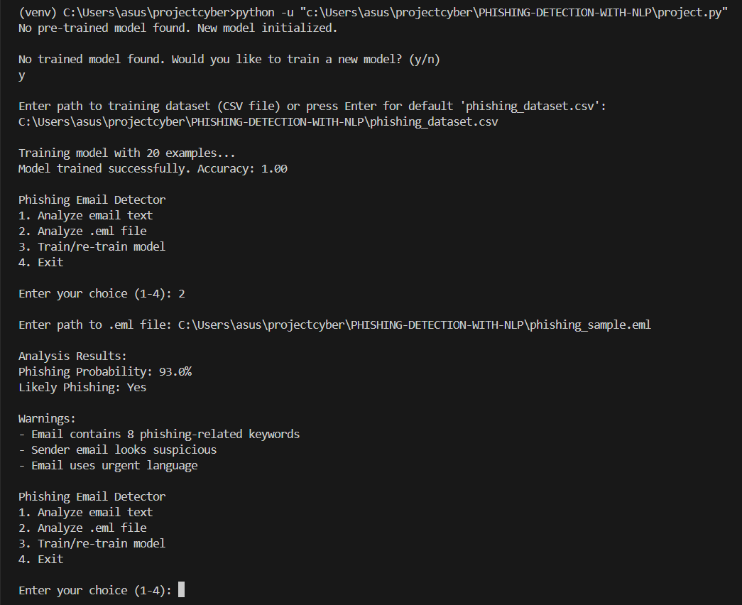
Results
Metric
Score
Accuracy
95%
Precision
93%
Recall
92%
High accuracy confirms effective phishing detection

Slide 9
Application Demo Overview
How It Works
Workflow
Email input scanned in real-time
Input emails → Feature extraction
Automatic classification of threat level
Classification with trained model
User receives phishing alert
Output with risk score

Slide 10

Conclusion & Next Steps
Achievements
Challenges
Reliable phishing detection using ML and NLP
Balance between accuracy and false positives
Future Enhancements
Integrate LLMs and real-time email scanning

